Slide 1
Capstone Project - Sports Analysis
By Abhishek Attri

Slide 2
Project Overview
This database consist of 11 data set.
In this dataset is a comprehensive collection of information about the Olympic Games, offering a detailed view of various aspects related to this prestigious international sporting event. It encompasses data from multiple interconnected tables, providing valuable insights into the history, sports, participants, and locations of the Olympic Games.

Slide 3
OBJECTIVES
Analyse how the Olympics have evolved over time for Male and female,analyse about the participation and performance of person based on different Countries, Season and different Sports and events, Person who won medals.
Analyse which country has the highest number of participants, which has the highest number of medals and most popular Sports among men and women.
Publish the finding based on data analysis.

Slide 4
Olympics
Participant Analysis
Valuable Insights: The Power BI dashboard using the Olympics Database provides valuable insights into the Sports performance.. It presents data-driven analytics on Medals, Gender, age of Participant etc.
Improvement Focus: The dashboard helps the Sports focus on areas that require improvement. By analyzing Games,Age, Countries, the dashboard identifies opportunities to optimize age and most valuable game.
Trend Identification: Using historical Sports data, the dashboard identifies trending game over time. It helps identify seasonal patterns and the success of certain games and Players. This trend identification empowers the games to plan for future Sports in Olampic more effectively.
Comprehensive Understanding: The Power BI dashboard offers a comprehensive understanding of Sports Played in Olamic. By presenting data on Games, best Player, and season in centralized platform. This comprehensive understanding enables better decision-making and a more cohesive strategy across all aspects of the Olamic Sports.
Medals Analysis
Season & Players Analysis
Sports Analysis
Age Analysis

Slide 5
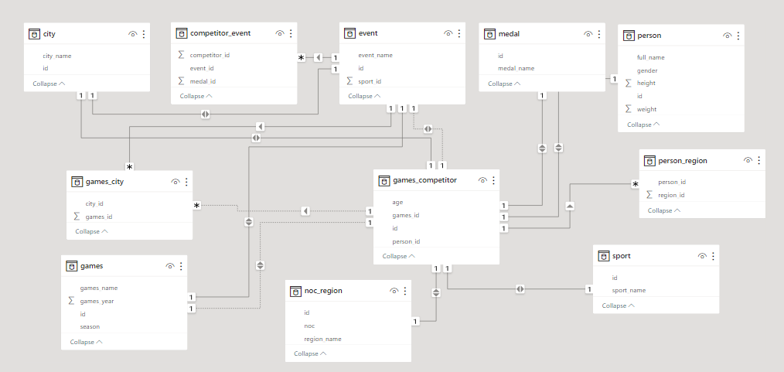
ER Diagram

Slide 6


Slide 7
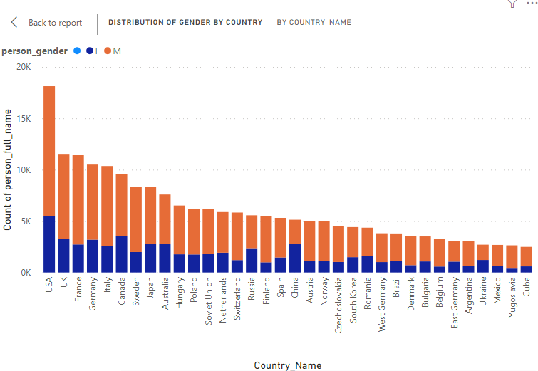
Male and Female Participation by Country

Slide 8
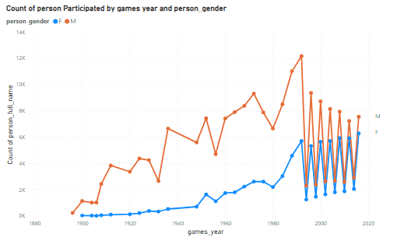
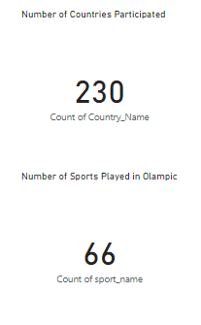
Sports Analysis

Slide 9
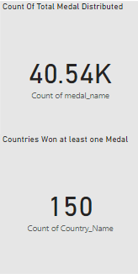
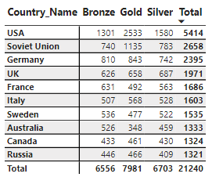
How many Medals distributed in top 10 Countries?
As shown in the table, the top 10 Countries According to numbers of Medals. The US has the highest number of medals follows followed by Soviet Union with Second highest number of Medals. Germany has third highest Medals.

Slide 10
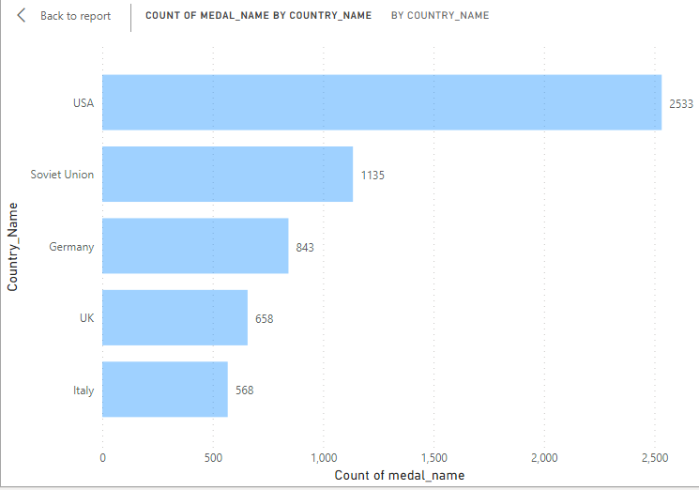
Top 5 Countries with Gold Medals
USA has won the highest number of Gold medals (2533) in Olympics Follows by Soviet Union with (1135) and Germany having third highest number of medals (843).

Slide 11
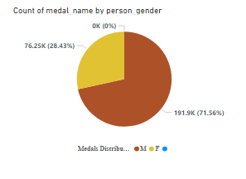
Medals by Gender
The number of male participant won in Olympics are more.
Whereas the number of Female won medals are significantly low as compared to male.

Slide 12
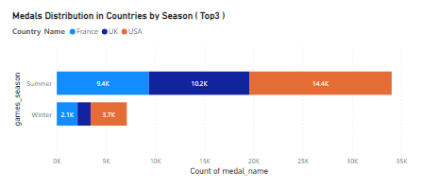
Season Analysis
In 1986, it was decided to separate Summer and Winter Games.
So, the number of Person participating in Summer are more as Winter, i.e numbers of Summer Medals are high as Winter Olympics.

Slide 13
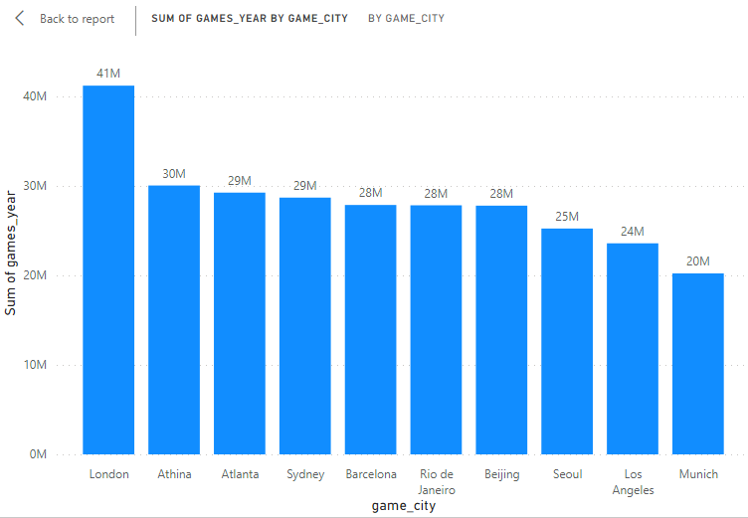
Most Suitable City for Olympic Games
The bar graph shows the top 10 cities with the highest number of games played.
London is the most suitable city for playing games followed by Athina.

Slide 14
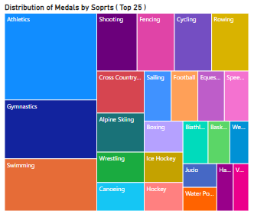
Sports Analysis
Athletics is the most popular sports in the world.
Athletics has highest number of medals followed by Gymnastics.

Slide 15
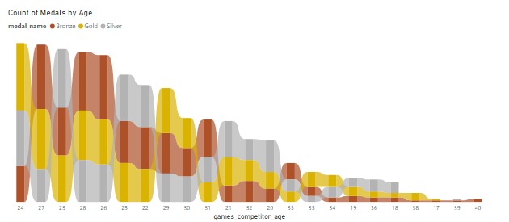
Age Analysis
Participants, Who are 24 year old has won highest number of medals followed by 27 year old person.

Slide 16
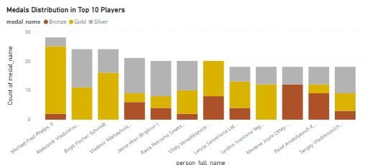
Top Players by Medals
Michael Fred Phelps,II is the best player of Swimming who has won ( 23 Gold + 3 Silver + 2 Bronze ) medals followed by Aleksandr Vladimirovich a swimmer and Biathlon Men’s who won ( 11 Gold +13 Silver) Medals.

Slide 17
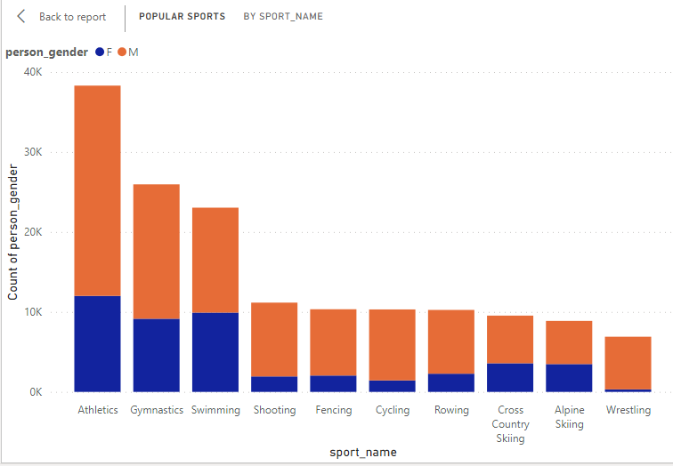
Popular Sports among Men and Women
Athletics and Gymnastics have most Participants.Most of the games we are team games. However, We do see some individuals event such as cycling, Wrestling and marathon among the top 10 popular Sports for men.
Athletics and Swimming are most popular individual sports for Women.

Slide 18
EDA questions
Are there any trends or patterns in the frequency of hosting Olympic Games?
= Athletics game has trends or patterns in frequency of hosting in Olympics.
Are there any notable events or occurrences associated with specific Olympic Games?
= Athletics events has highest number of Participants.
Are there any emerging sports that have been recently added to the Olympics?
=Rugby sevens add recently in 2016.
Are there any sports that have a higher number of events for one gender compared to others?
= Athletics and Gymnastics is popular in men but Athletics and Swimming is popular in Female.
Are there any new events that have been introduced in recent editions of the Olympics?
=Rugby sevens event introduce in recent editions of the olympics
Are there any events that have been discontinued or removed from the Olympics?
=Aeronautics have been discontinued after 1936.

Slide 19
Thank You

